Slide 1
Climate Change
Challenges & Solutions

Slide 2
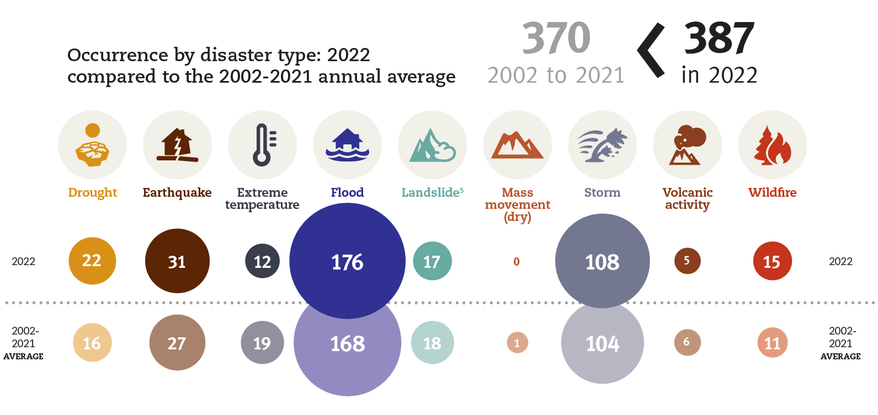
Nat Cat Losses
Globally, Over the past decade, disasters have taken a heavy toll:
Killing more than 700,000 people;
Injuring 1.4 million, and
Displacing 23 million people.
In general, more than 1.5 billion people have been affected by disasters, according UNE
During 2022 alone, the economic losses due to natural disasters amounted to US$ 284 billion (US$ 275 billion by natural disasters, US$ 9 billion by man-made), according to (Sigma Report 1/2023)
In 2022, Insured losses due to natural disasters amounted to US$ 125 billion from total Insured losses amounted to US$ 132 billion, according to (Sigma Report 1/2023)

Slide 3
Nat Cat Losses
In Q1 2023
The total economic loss was the highest Q1 total since 2011 (USD383 billion in 2023 USD).
Public and private insurance entities covered at least USD22 billion of that total.
The protection gap was 72% (USD55 billion).
Source: Gallagher

Slide 4
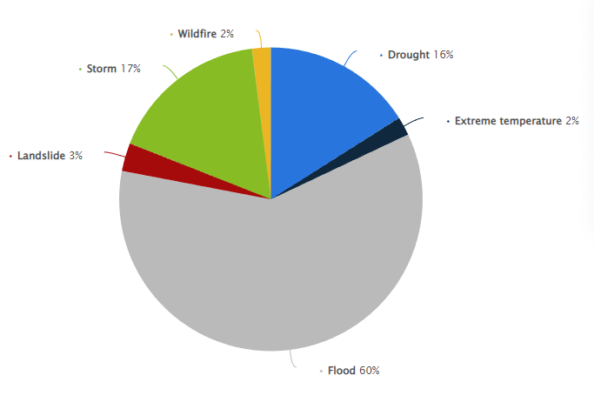
Nat Cat Losses
In Africa, between 1970 and 2019, about 1.7 thousand natural disasters causing economic losses of about 38.5 billion US dollars
Africa is particularly vulnerable to climate change compared to other regions of the world.

Slide 5
Climate Change In Arab Countries

Slide 6
Since the 1980s
The average number of natural disasters in the MENA region has nearly tripled over the same period
During the past 30 years
+270 disasters
Injuring nearly 10 million people
Killing +150 thousand people
Arab Countries
The impact of Claim Change

Slide 7
List of countries by natural disaster risk (2011-2022)
Countries | Years | Group 2
 | 2011 | 2012 | 2013 | 2014 | 2015 | 2016 | 2017 | 2018 | 2019 | 2020 | 2021 | 2022
Algeria | 8.06 | 8.15 | 8.13 | 7.63 | 7.53 | 7.36 | 7.36 | 7.54 | 7.66 | 7.55 | 7.66 | 9.58
Egypt | 2.38 | 2.33 | 2.34 | 2.29 | 2.26 | 2.29 | 2.29 | 1.90 | 1.84 | 1.78 | 1.82 | 20.65
Morocco | 7.17 | 7.21 | 7.13 | 6.80 | 6.76 | 6.45 | 6.45 | 6.13 | 5.83 | 5.82 | 5.82 | 10.29
Oman | 2.80 | 2.72 | 2.74 | 2.74 | 2.75 | 2.64 | 2.64 | 2.69 | 2.74 | 2.76 | 2.54 | 7.27
Sudan | 9.25 | 7.88 | 7.87 | 8.08 | 8.02 | 7.99 | 7.99 | 9.41 | 8.52 | 8.45 | 8.47 | 10.12
Yemen | 6.83 | 5.98 | 6.03 | 6.07 | 6.00 | 5.97 | 5.97 | 6.43 | 5.50 | 5.68 | 5.72 | 24.26
Rank | Country | Risk
1 | Philippines | 46.82
2 | India | 42.31
3 | Indonesia | 41.46
4 | Colombia | 38.37
5 | Mexico | 37.55
14 | Somalia | 35.49
15 | Yemen | 24.26
101 | Germany | 3.92
184 | Bahrain | 0.95
192 | Andorra | 0.26
 | Monaco | 0.26
Very High
High
Average
Low
Very low
Source: WorldRiskReport 2022, Ruhr University Bochum (RUB) & Bündnis Entwicklung Hilft

Slide 8
The Concept of the World Risk Index
Exposure
Number and share of the population regarding
Intensity Levels
Earthquakes
Tsunamis
Cyclones
Coastal Floodings
Riverine Floodings
Droughts
Sea-level rise
WRI =$\sqrt{Exposure x Vulnerbity}$
Economic development
Vulnerability
is composed of
Susceptibility
Economic deprivation
Source: WorldRiskReport 2022, Ruhr University Bochum (RUB) & Bündnis Entwicklung Hilft

Slide 9
The most important NAT CAT in the Arab region
Country | EQ | EQ | Floods |  | Drought & Extreme heat** |  | Cyclones |  | Wildfire
 | Year | Economic Losses (Billion USD$) | Year | Economic Losses (Billion USD$) | Year | Economic Losses (Billion USD$) | Year | Economic Losses (Billion USD$) | Year | Economic Losses (Billion USD$)
Algeria | 1980 | 5,200 |  |  |  |  |  |  | 2010-2019 | 11
 | 2003 | 5,000
Egypt | 1992 | 1,200
Jordan |  |  |  |  | 1992 | 400
Morocco | 1960 | 290 |  |  | 1999 | 900 |  |  | 2022 | 69
Lebanon |  |  |  |  |  |  | 1992 | 155
Oman |  |  |  |  |  |  | 2007 | 4,000
 |  |  |  |  |  |  | 2021 | 1,900
Sudan |  |  | 2020 | 3-4
Syria* | 2023 | 45
Tunisia |  |  | 1990 | 243 |  |  |  |  | 2021 | 64
Yemen |  |  | 1996 | 1,200
* February 6th earthquakes in Turkey & Syria ** The small percentage related to Drought is due to the limited available information

Slide 10
Arab Countries
3 Solutions
Establishment of a national emergency fund
Agricultural Insurance (Cereals, pulses and oilseeds - Arboriculture – Dryness Insurance)
CAT
FSEC
"Individual" insurance coverage against natural disasters based on the issuance of an insurance policy to the insured person
Studying and preparing
Morocco
Algeria
Initiatives
Oman
Tunisia

Slide 11
Solutions
Arab Risk Insurance Pool

Slide 12
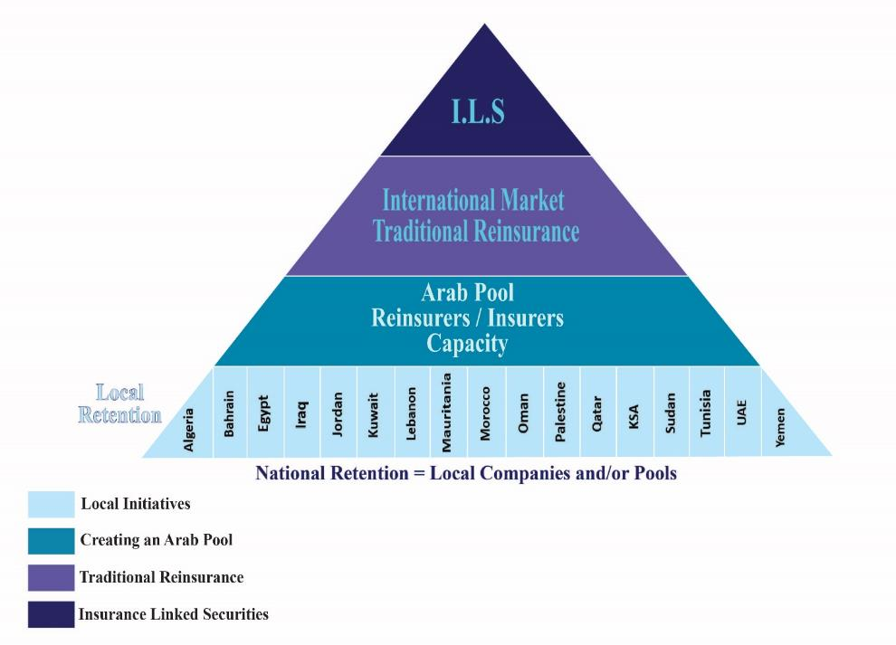
Arab Risk Insurance Pool
What we need to do?
To Collect all information about natural disasters
Create disaster maps for Arab countries
Catastrophes Modeling
To launch an Arab pool between Arab Insurance & Reinsurance Companies

Slide 13
Arab Risk Insurance Pool
Resources
International Organization (AFD, IMF, WB)
Regional Organization (IDB - Arab Monetary Fund)
Government Support
Insurance Policies

Slide 14
THANK YOU
General Arab Insurance Federation (GAIF)
gaif.org
gaif@gaif.org

